Slide 1
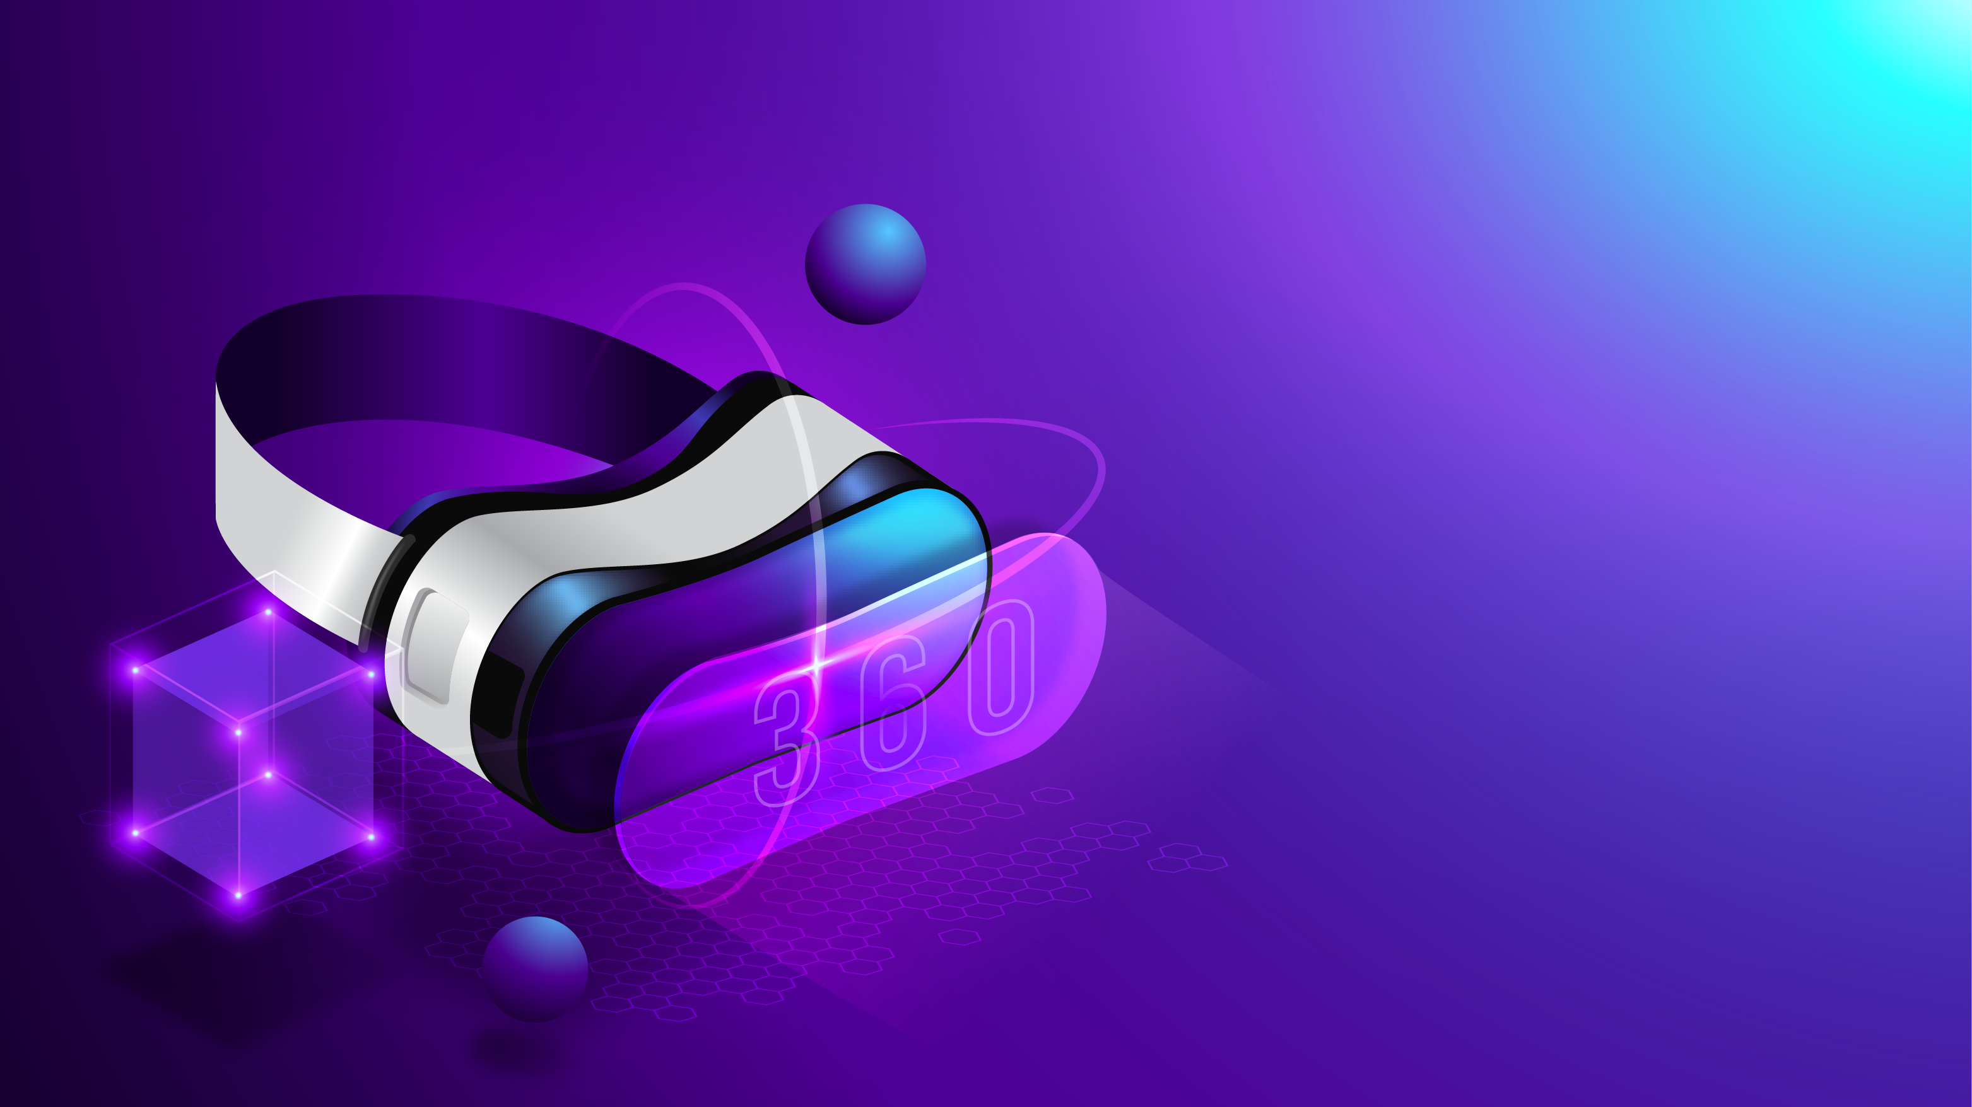
Metaverse
A virtual ecosystem for all. Explore, work, and play. Shape your own metaverse experience

Slide 2
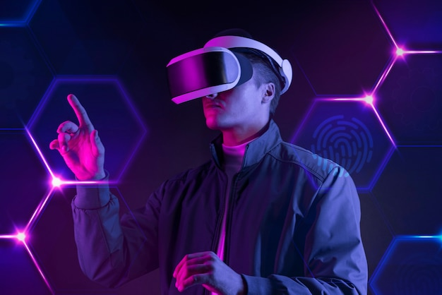
Virtual Main Streaming
Machine Intelligence
Simulating Reality
Challenges By Open Platforms
Rise Of Cybernetics
Accelerating Distributed Networks
Walled Garden Ecosystems
Metaverse
Low-code Platforms
Blockchain Adoption

Slide 3
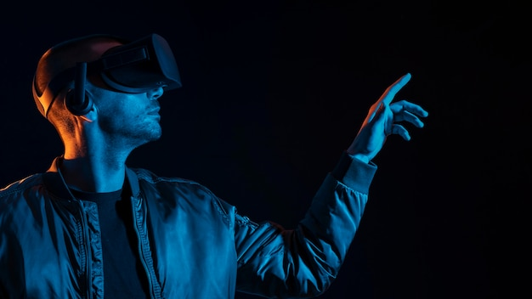
Metaverse will include elements from both physical and virtual worlds
The metaverse will be decentralized
(Just like the internet)
Nobody owns the metaverse like how nobody owns the internet. It is an open platform
Metaverse
A metaverse is a form of mixed reality i.e., a combination of augmented and virtual reality

Slide 4
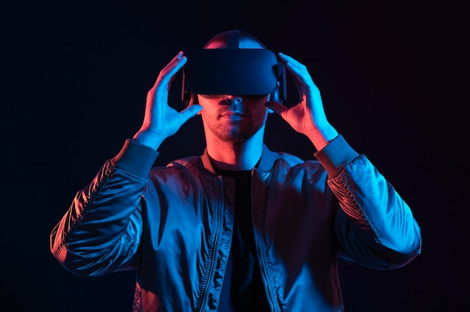
Metaverse
Metaverse will introduce digital elements in the real world.
Metaverse will support 3D virtual spaces.
3D spaces in the virtual world will let you socialize, learn & play in ways that go beyond what we can imagine
Metaverse is expected to expand the internet to combine digital spaces like online gaming, social media, VR, cryptocurrency, etc.

Slide 5
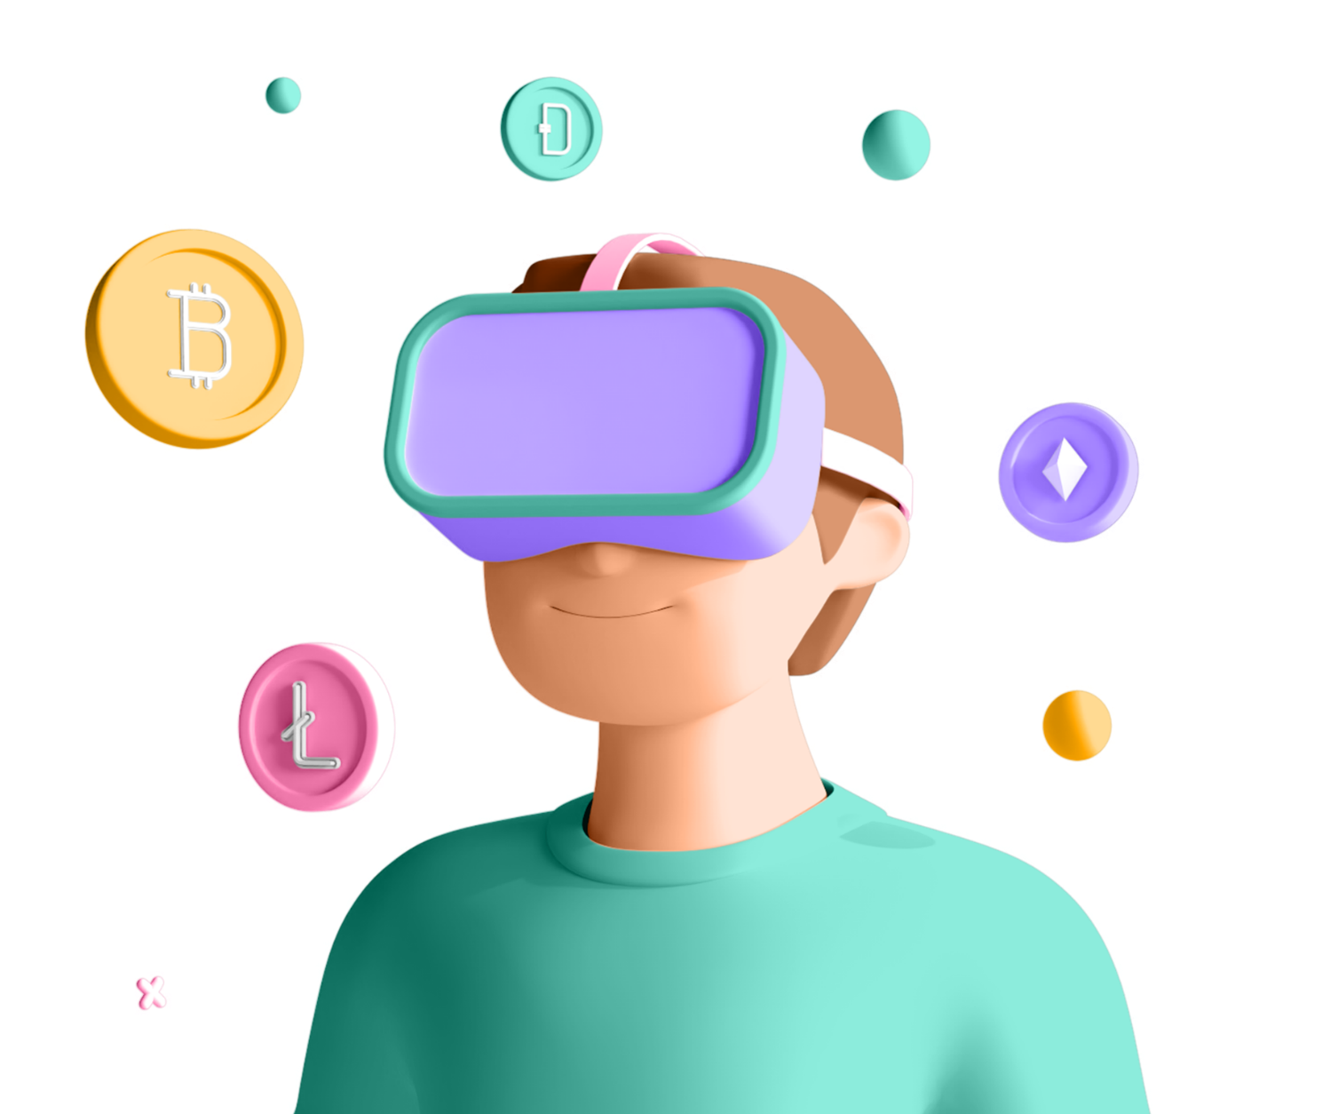
Displaying A Vast Array Of Dimensions, We Create A Leap In Innovation For Your Brain
Meta defines the metaverse as "a set of virtual spaces where you can create and explore with other people who aren't in the same physical space as you.”

Slide 6
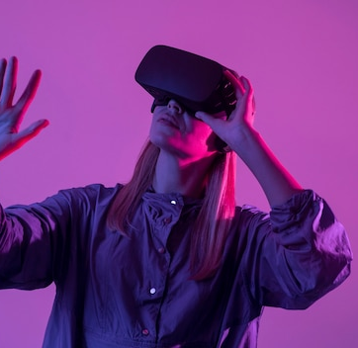
Metaverse
Implementations
Components of metaverse technology have already been developed within online video games.
The 2003 virtual world platform Second Life is often described as the first metaverse, as it incorporated many aspects of social media into a persistent three-dimensional world with the user represented as an avatar, however historical claims of metaverse development started soon after the term was coined.

Slide 7
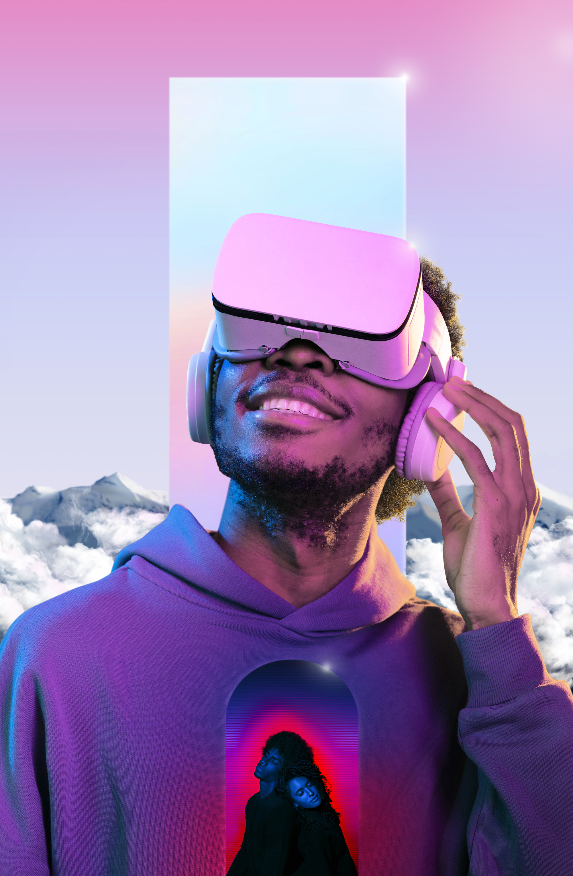
Virtual and augmented reality experience
Dynamic Lighting
Foveated Rendering
Motion Tracking
Positional Sensor

Slide 8
Metaverse
User safety
User addiction and problematic social media use is another concern. Internet addiction disorder, social media, and video game addiction can have mental and physical repercussions over a prolonged period of time, such as depression, anxiety, and various other harms related to having a sedentary lifestyle such as an increased risk for obesity and cardiovascular disease.
Experts are also concerned that the metaverse could be used as an 'escape' from reality in a similar fashion to existing internet technologies.

Slide 9
7 Layers Of The Metaverse
Experience
Games, Social esports, theater, shopping
Discovery
Ad networks, Social curation, ratings, stories agents
Creator Economy
The design took asset materials, workflow, commerce
Spatial Computing
3D engines, VR/AR/XR, multitasking UI, Geospatial mapping
Decentralization
Edge computing, AI agents, microservices, Blockchain
Human
Interface
Mobile, smart glasses, wearables, haptic, Gestures, Voice, Neutral
Infrastructure
5G, Wi-Fi 6, 6G, Cloud, GPUs, materials

Slide 10
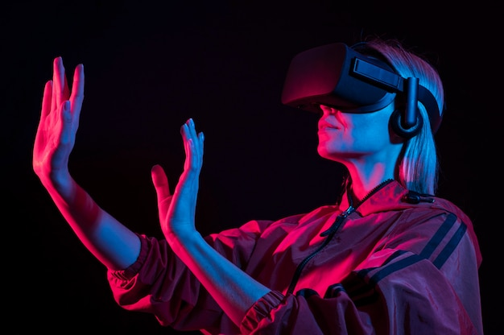
A Step forward to a world where all kinds of imaginations come true
The Metaverse is a hypothetical future version of the internet built around immersive virtual worlds, virtual reality, and augmented reality.
It isn’t here yet, but the concept is it will allow people to work, play, converse, learn, shop, and more through a unified virtual experience.

Slide 11
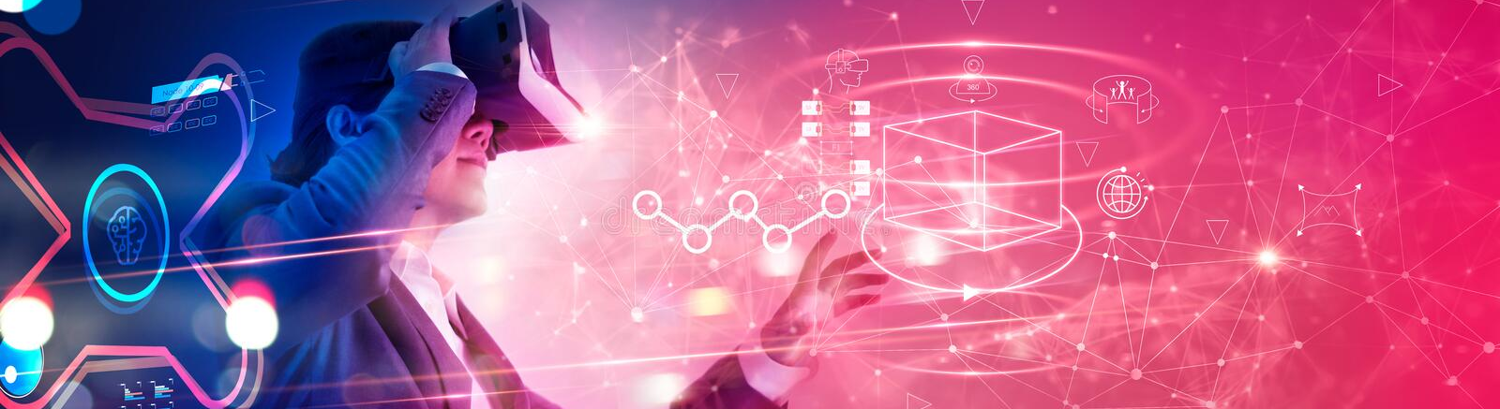
Metaverse Will Be Future Technology
Meta defines the metaverse as "a set of virtual spaces where you can create and explore with other people who aren't in the same physical space as you.”

Slide 12
Turning Dream To Reality
Reach Out & Let Your Mind Explore
Augmented reality
Collision Detection
Interactive narrative
Head Tracking

Slide 13
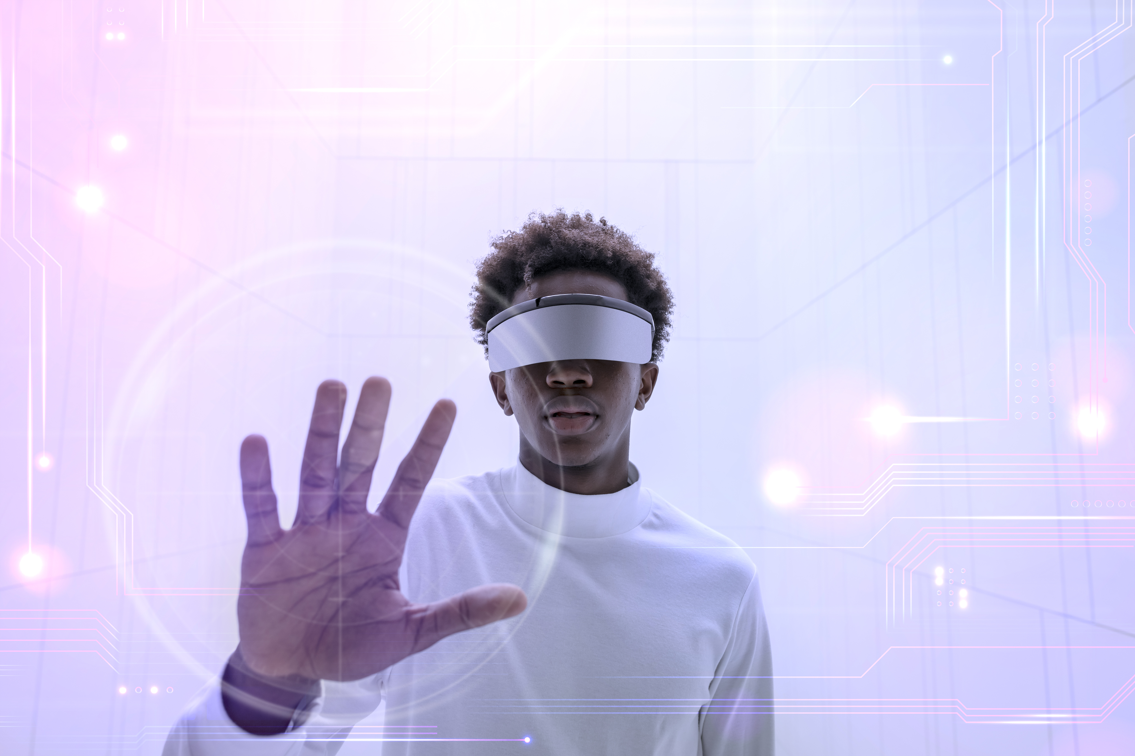
Metaverse
Enter the metaverse Play, create, own, and govern a virtual world made by players

Slide 14
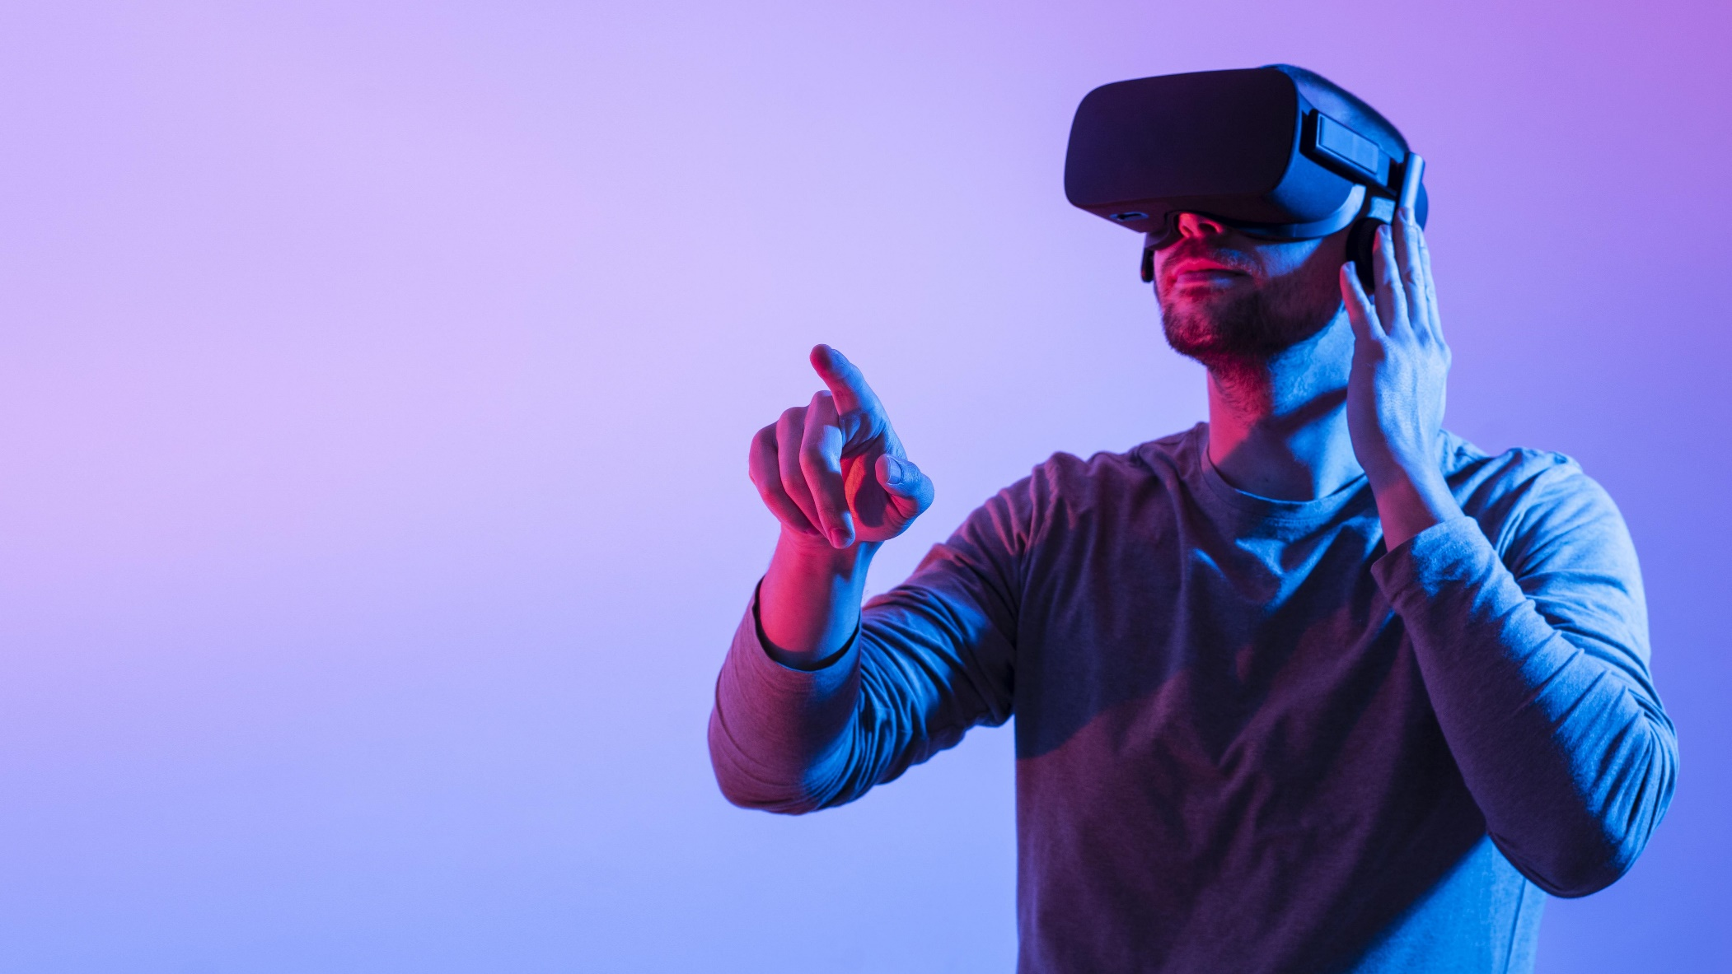
Metaverse
Virtual reality construct intended to supplant the internet
50+
Game Simulator
192K+
Avatar with NFT

Slide 15
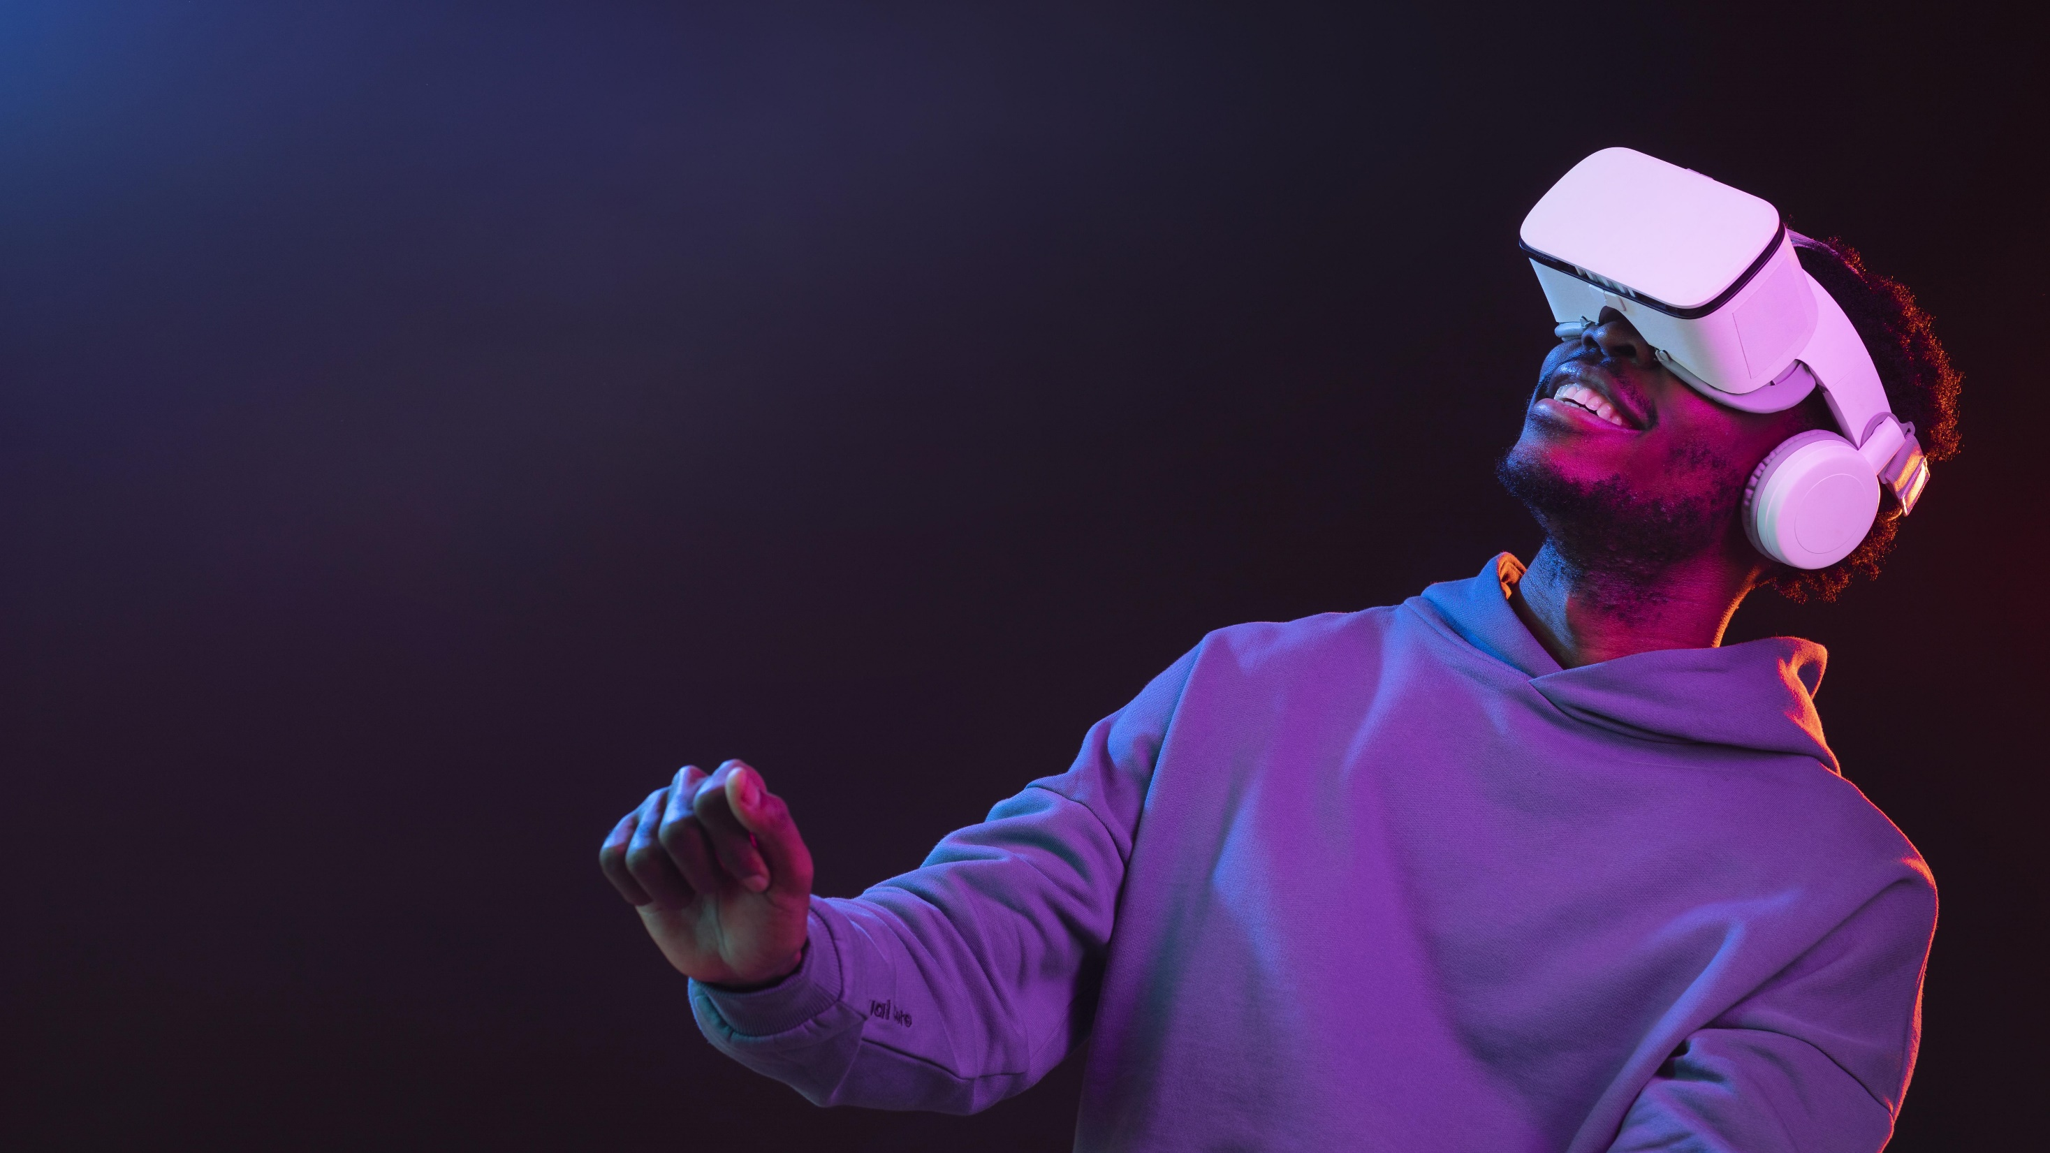
Thank You!
By Syed Hammas Ali

